Slide 1
Impact of Social Sciences, Humanities and Arts Conference
Opening Session on:
Policy Frameworks for SSHA Impact
13 October, 2021

Slide 2
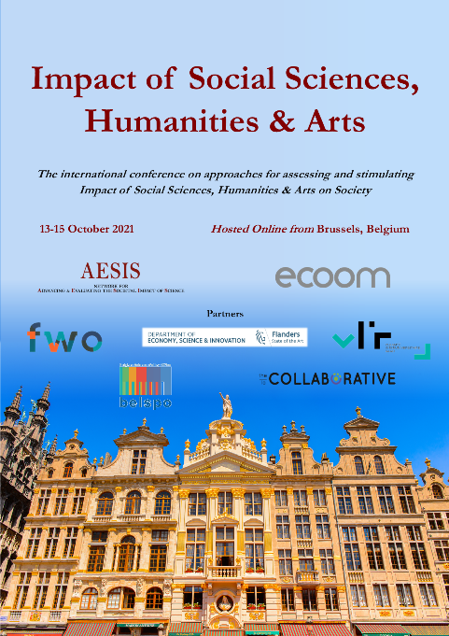
Impact of Social Sciences, Humanities and Arts
13-15 October, 2021
Johan Hanssens: Secretary-General of the Flemish Departmentof Economy, Science, and Innovation, Belgium
Kristin Davidse: Full Professor, English Linguistics, FunC Research Group, KU Leuven
Rajesh Tandon: Founder-President & Chief Functionary, Participatory Research in Asia, UNESCO Co-Chair, Community Based Research & Social Responsibility in Higher Education, India
Ted Hewitt: President of the Social Sciences and Humanities Research Council, Canada
Geoff Mulgan: Professor of Collective Intelligence, Public Policy
and Social Innovation at University College London
Overview of the Keynote Speakers
#SSHA21

Slide 3
Impact of Social Sciences, Humanities and Arts
13-15 October, 2021
Johan Hanssens
Secretary-General of the Flemish Departmentof Economy, Science, and Innovation, Belgium
#SSHA21

Slide 4
13 october 2021, AESIS-Conference
Societal Impact of SSHA
Johan Hanssens, Secretary-general Department EWI

Slide 5
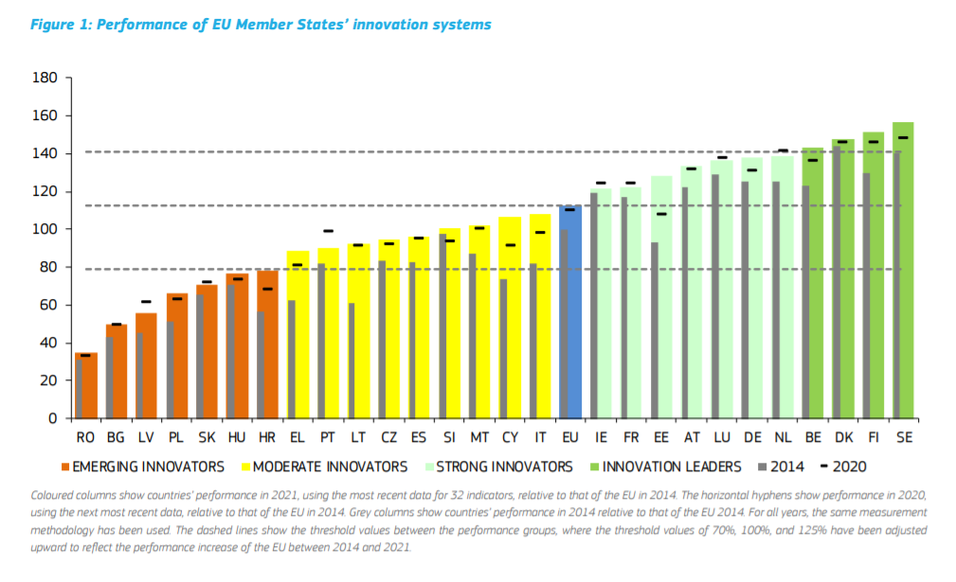
Belgium: chocolate, waffles, beer and … SCIENCE
Belgium = 4th best in EU
Belgium ranks 4th best in the European Innovation Scoreboard 2021
Belgium has one of the highest ‘R&D intensity’ in the world (3,17% GDP in 2019)

Slide 6
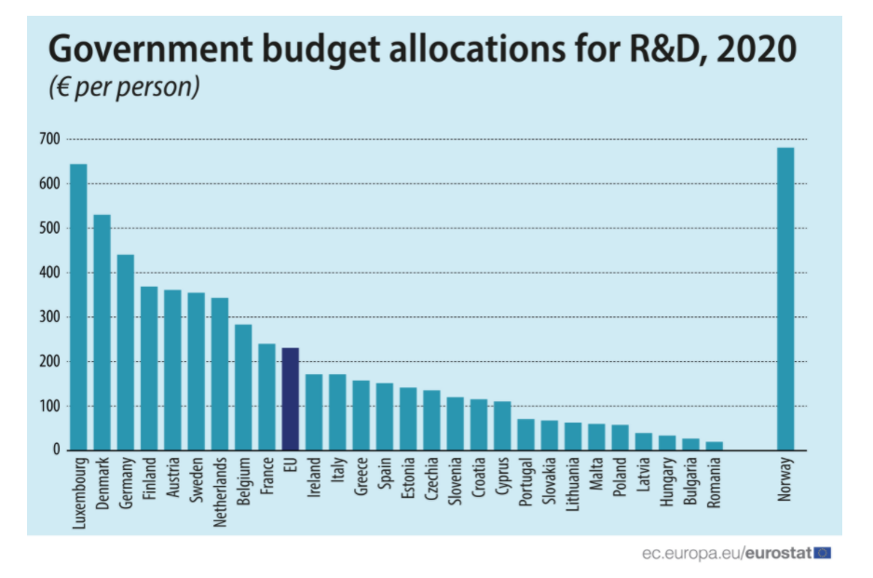
1. Why ‘impact’ matters?
EU-27 = 100,7 billion € (0,75% GDP)
Belgium = 3,3 billion € (0,73% GDP)
285 € per person
USA = 144 billion €
(0,79% GDP)
Public money = accountability
Source:
https://ec.europa.eu/eurostat/web/products-eurostat-news/-/ddn-20210915-1

Slide 7
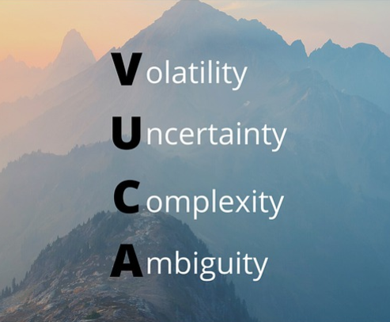
2. Impact assessement: complex topic
Impact measurement in a VUCA-world …

Slide 8
3. From ‘inputs’ to ‘impacts’ in science (1)…
No ‘one to one relationship’ between resources/activities and impacts…
Source: Grinience, E. et. al., RI-PATHS, Guidebook for socio-economic impact assessment of research infrastructures, 2020.

Slide 9
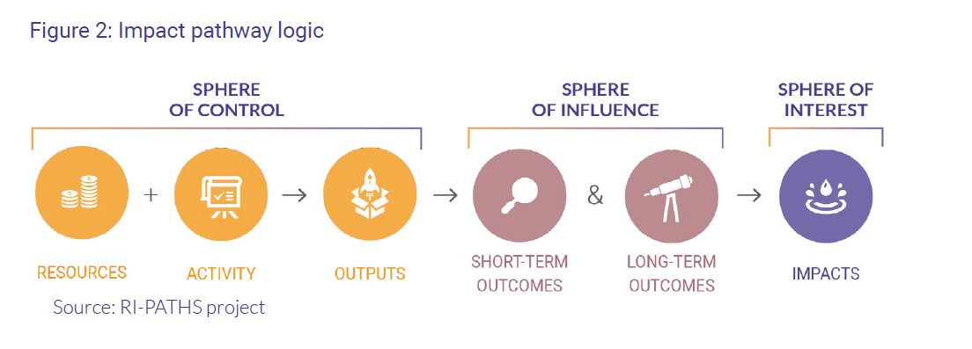
3. From ‘inputs’ to ‘impacts’ in science (2)…
Not a lineair path …
But open, non-linear and networked systems
Source: Grinience, E. et. al., RI-PATHS, Guidebook for socio-economic impact assessment of research infrastructures, 2020.

Slide 10
4. Societal challenges → ‘wicked problems’
Grand societal challenges climate, energy, mobility, food, … = systemic challenges
Science = necessary condition, not a sufficient condition for solving ‘wicked problems’
Need for inter-, multi- and transdisciplinary approach + reaching out to other actors in society
Transformative innovation and system thinking

Slide 11
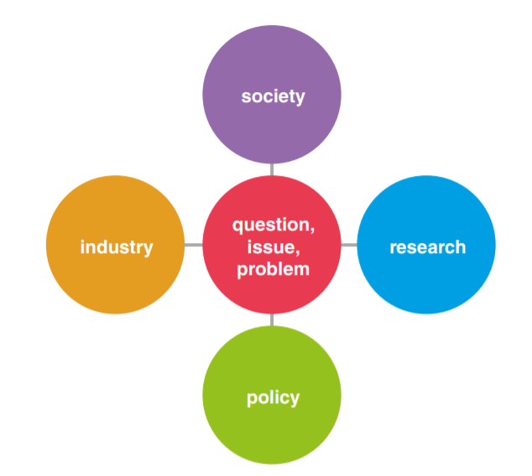
5. ‘Productive interactions’ to increase impact (1)

Slide 12
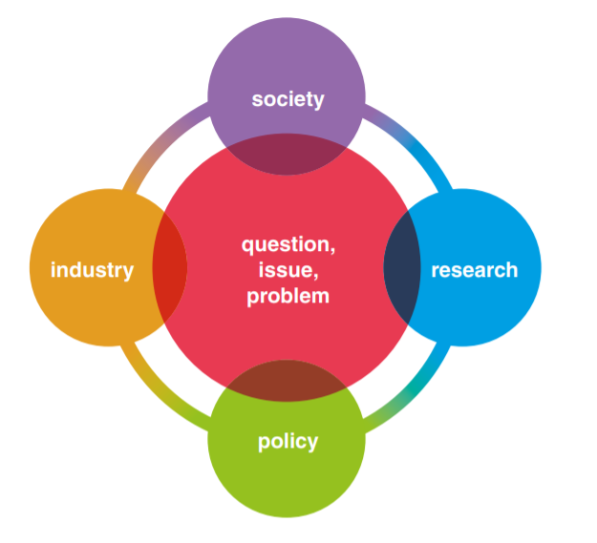
5. ‘Productive interactions’ to increase impact (2)
‘Quadruple helix’- settings
Invest in connectingthe actors

Slide 13
6. International cooperation to increase impact
World
Europe
Belgium
Flanders
IMPACT

Slide 14
Thank you
Johan Hanssens
Secretary-general
Flemish Government
DEPARTMENT OF ECONOMY, SCIENCE & INNOVATION
T +32 2 553 55 99, F +32 2 553 60 07 M +32 477 556 103
johan.hanssens@vlaanderen.be
Koning Albert II-laan 35 box 10, B-1030 Brussels
www.ewi-vlaanderen.be

Slide 15
Impact of Social Sciences, Humanities and Arts
13-15 October, 2021
Kristin Davidse
Full Professor, English Linguistics, FunC Research Group, KU Leuven, Belgium
#SSHA21

Slide 16
POLICY FRAMEWORKS FOR SSHA IMPACT Kristin Davidse (KU Leuven)
Impact of Social Sciences, Humanities and Arts 2021
Hosted online from Brussels (Belgium), 13-15 October 2021
Notes:
/

Slide 17
How can SSHA research impact and transform society for betterment of all actors involved?
How can policy making advance this impact?
Notes:
/

Slide 18
How can SSHA research impact and transform society?

Slide 19
How can SSHA research impact and transform society
reflect on fundamentals, e.g.
what values and goals inform frames of reference such as Research Excellence Framework (UK), Sustainable Development Goals (UN)?
growth of GDP or well-being
local vs global
repudiate perception that (some) SSHA research can do little to impact society by showing that it can impact society, particularly through interdisciplinarity
Notes:
/

Slide 20
How can SSHA research impact and transform society
stimulate reflection and debate on action goals of frames of reference:
Impact on | REF (UK) | EU | SDGs (UN)
Economy | new products, businesses, services | generation of innovation-based growth | sustained, inclusive and sustainable economic growth
 | business growth & jobs | creating more & better jobs | full & productive employment and decent work for all
Notes:
Cf. Note: terms used for goals almost always connotations of ‘more’ and ‘new’, ’more man-made effect on world’, etc. not with ‘restoration’, ‘stabilization’, ‘re-using’, ‘limiting’ growth
UN SDGs : most explicitly value-driven (equity, justice, reduce injustice and inequality); societal impact subsumes society, economy and environment

Slide 21
How can SSHA research impact and transform society
What sort of growth?
"Economic growth accompanied by worsening social outcomes is not success. It is failure.“
“While sustainability is far from languishing on the corporate periphery, far more effort is needed―and fast.”
Notes:
/

Slide 22
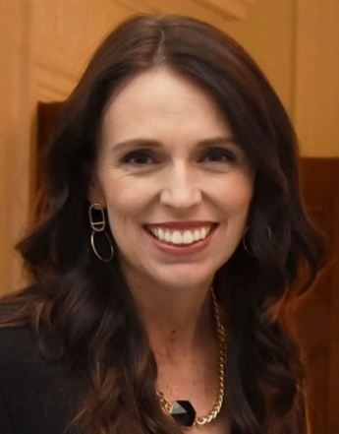
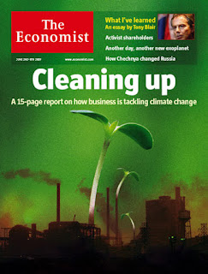
How can SSHA research impact and transform society
“Economic growth accompanied by worsening social outcomes
is not success. It is failure.” (New Zealand PM Jacinda Ardern)
“While sustainability is far from languishing on the corporate
periphery, far more effort is needed―and fast.” (The Economist)
(non-politicized) values are central to debate on shared action goals
Notes:
Note: ‘cleaning up’: restorative action
Not all research-fuelled action is benign, note:
society

Slide 23
How can SSHA research impact and transform society
SSHA can bring science to citizens and bring them together on shared action goals
e.g. climate change action (Thinkers’ Programme ‘The language of debate & communication about climate change in Flanders at the Royal Flemish Academy)
philosophy and religious sciences (meaning of life, ‘economy of happiness’, ethics, etc.)
linguistics (relation between concepts and terms and their connotations)
communication studies (identifying representation frames in traditional & social media)
art (engaging citizens)
psychology (denial, motivation)
education (interacting with youth)
anthropology (e.g. transcultural perspectives on values and actions)
economics (costs of (more) action vs. (more) non-action)
Notes:
/

Slide 24
How can SSHA research impact and transform society
all SSHA research can do a lot to ‘better’ society particularly via interdisciplinarity
within SSHA
with science and technology
with biomedical sciences
“SDGs are integrated—they recognize that action in one area will affect outcomes in others, and that development must balance social, economic and environmental sustainability. […] The creativity, knowhow, technology and financial resources from all of society is necessary to achieve the SDGs in every context.” (Sustainable Development Goals | United Nations Development Programme (undp.org)
Notes:
/

Slide 25
How can policy making advance SSHA impact on society?

Slide 26
How can policy making advance SSHA impact
societal impact as factor
in agenda-setting of research topics, nature of research, etc.
in evaluation of research funding
Notes:
/

Slide 27
Societal impact as factor in agenda-setting of research
in consultation with stakeholders, decide to what extent societal impact
motivates research lines (calls of funding bodies, research planning by research institutions, etc.)
correlates with specific types of research (interdisciplinary, ‘applied’, etc.)
opens up modes and audiences of research communication (open access, science communication, etc.)
affects formats of project grants (added duration, means, etc.)
may be upgraded as a factor determining research policy

Slide 28
Societal impact as factor in agenda-setting of research
Peter Doherty, Doctor honoris causa, U Gent 2009:
What is unique to university research, as opposed to industrial research, is that it is independent and multi-disciplinary, which is what is needed to address today’s major problems like climate change.
Peter Doherty Institute for Infection and Immunity (Melbourne)
Discover: break new ground and innovate
Deliver: work to improve health practice and outcomes
Inspire: develop highest calibre people to achieve excellence
Connect: engage locally and globally with our partners, stakeholders, colleagues and community

Slide 29
Societal impact as factor in agenda-setting of research
tension between
academic freedom
accountability towards ‘bettering’ society
Notes:
Some will say there isn’t or needn’t be a tension. I would say there is a tension that policy making on research and research funding should be aware of.

Slide 30
Societal impact as factor in agenda-setting of research
tension between
academic freedom
pursuing individual or group’s own research agenda
accountability towards ‘bettering’ society
have research agenda determined at least partly by societal needs
-> possible higher starting up costs and slower academic yields have to be offset by e.g. institutional support and rewarding of societal impact in evaluation of funding applications, careers, institutes, etc.
Notes:
Some will say there isn’t or needn’t be a tension. I would say there often is this tension. Academic freedom: positive: individual researcher or research group are doing what they are best at and most motivated for and societal impact will flow anyway from the excellence of the research. And researchers are operating under so much pressure already that demanding them to deflect their research to societal needs is asking too much. A more jaundiced view might be that ‘academic freedom’ can be invoked to ‘do more of the same’, to not ‘pay back’ the funding received from society, to not open up to more interdisciplinary research which has higher starting-up costs

Slide 31
Societal impact on evaluation of research funding
research funded by
tax-payers
donors
industry & businesses
motivations for evaluating research impact (ISRIA)
advocacy
analysis
accountability
allocation
evaluation of ‘research impact’ in community of researchers strongly developed, but not societal impact
Notes:
strong focus on bibliometrics: may determine and limit choices, may keep researchers focused on ‘doing more of the same’ within their own niche, rather than open up to research (partly) motivated by societal impact, which typically involves cutting across disciplines

Slide 32
Societal impact on evaluation of research funding
reflection and dialogue with all stakeholders to give ‘societal impact’ its due in evaluation of research
determine importance (‘percentage’) of societal impact in evaluations
differentiate ‘societal impact’ according to whether evaluation of
applications for research funding ex ante
results of granted funding ex post
careers (promotions)
research groups (e.g. consider entrepreneurial funding)
Notes:
/

Slide 33
Conclusion
SSHA should reflect on values and goals in frames of reference
SSHA has crucial role in bringing science to citizens and bringing them together on shared action goals, particularly through interdisciplinarity
societal impact should be reflected on and optimized in
agenda-setting of research topics
evaluation of research funding
Notes:
/

Slide 34
References
The Peter Doherty Institute for Infection and Immunity | Doherty Website
The Global Goals
Jacinda Ardern Says Economic Growth Is Pointless If People Aren't Thriving (globalcitizen.org)
Language and Climate | KVAB
\.... The International School on Research Impact Assessment ..../ (theinternationalschoolonria.com)
Home - REF 2021
Home | United Nations Development Programme (undp.org)
Notes:
/

Slide 35
Impact of Social Sciences, Humanities and Arts
13-15 October, 2021
Rajesh Tandon
Founder-President & Chief Functionary, Participatory Research in Asia, UNESCO Co-Chair, Community Based Research & Social Responsibility in Higher Education, India
#SSHA21

Slide 36
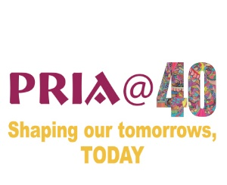
Annual conference on Societal ‘Impact of Social Sciences, Humanities, and Arts. Organised by AESIS
Dr. Rajesh Tandon, Founder President, PRIA
UNESCO Co-Chair, Community Based Research and Social Responsibility in Higher Education
October 13, 2:15 pm IST

Slide 37
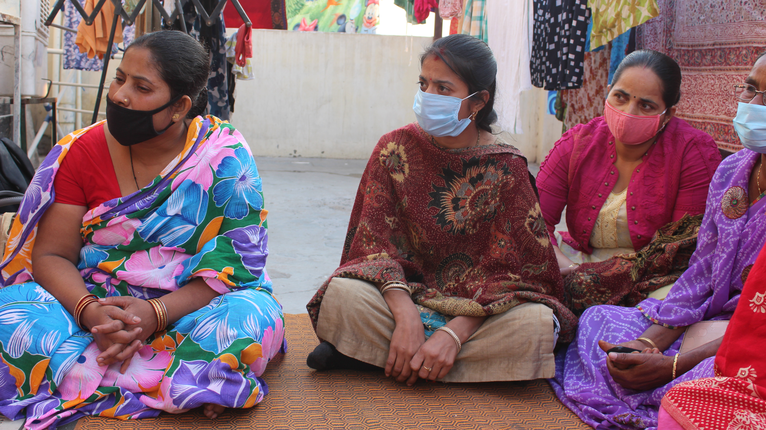
Distress to women domestic workers during Covid-19
Loss of income
Loss of livelihood
Loss of dignity (Labelled as “Corona Carriers”)
Loss of security and increased violence

Slide 38
Traditional Research Goes Like..
Design & conduct research
Report findings in journals to professional peers
Communicate with policy-makers
Programs designed for DW
Trickle down impact on DW families

Slide 39
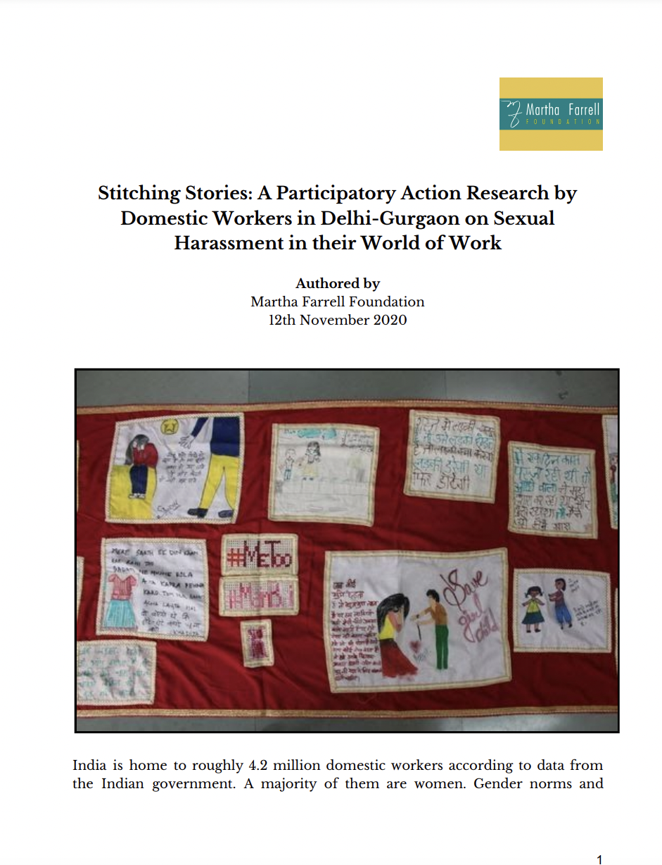
Alternative PR model.. Phase 1:
Joint data-collection
Analysis together, linking micro with macro
Researchers & DW frame research
?
?
Read full report of the Saree Project here

Slide 40
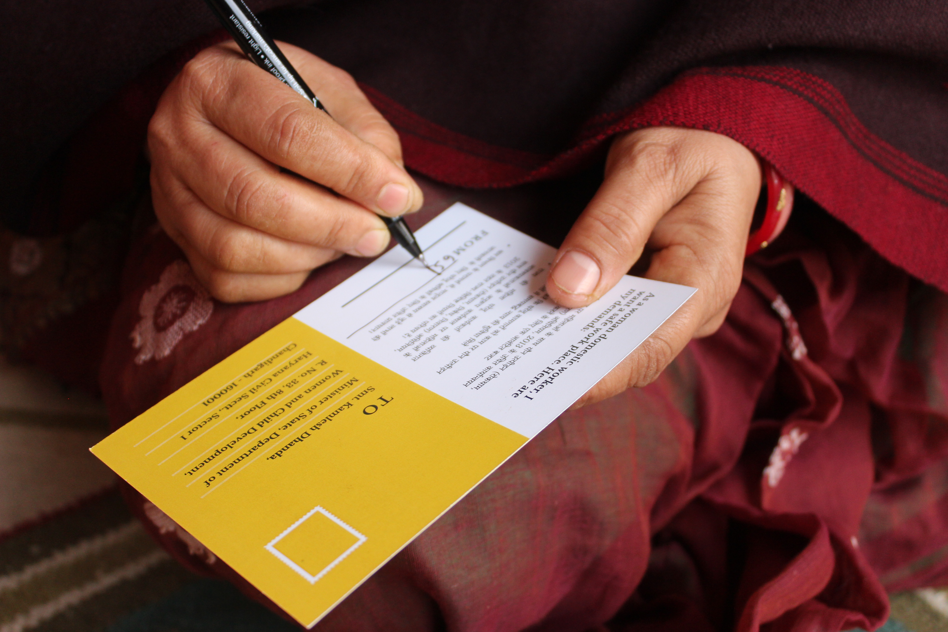
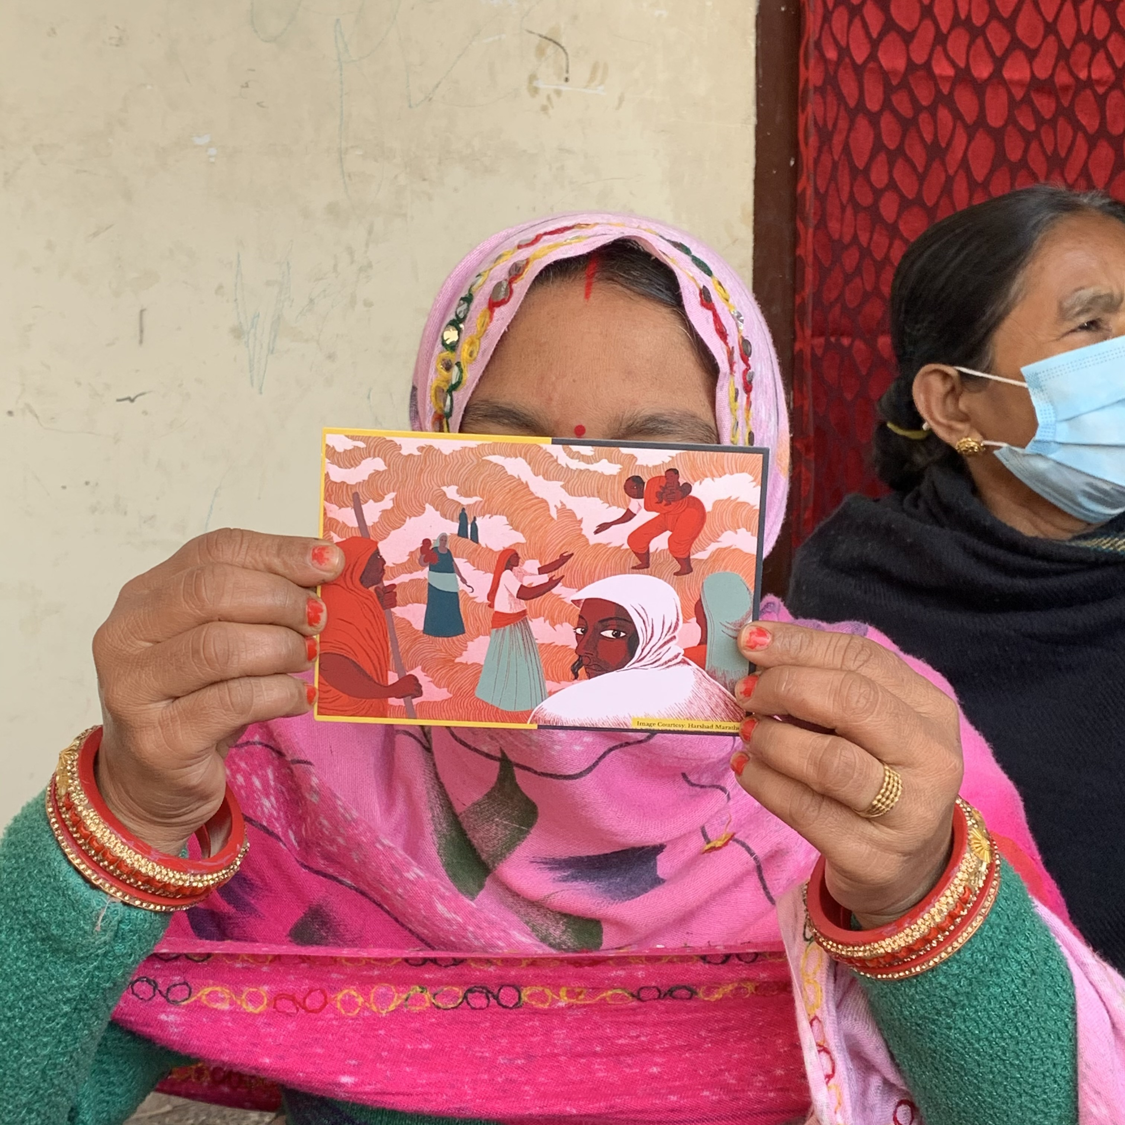
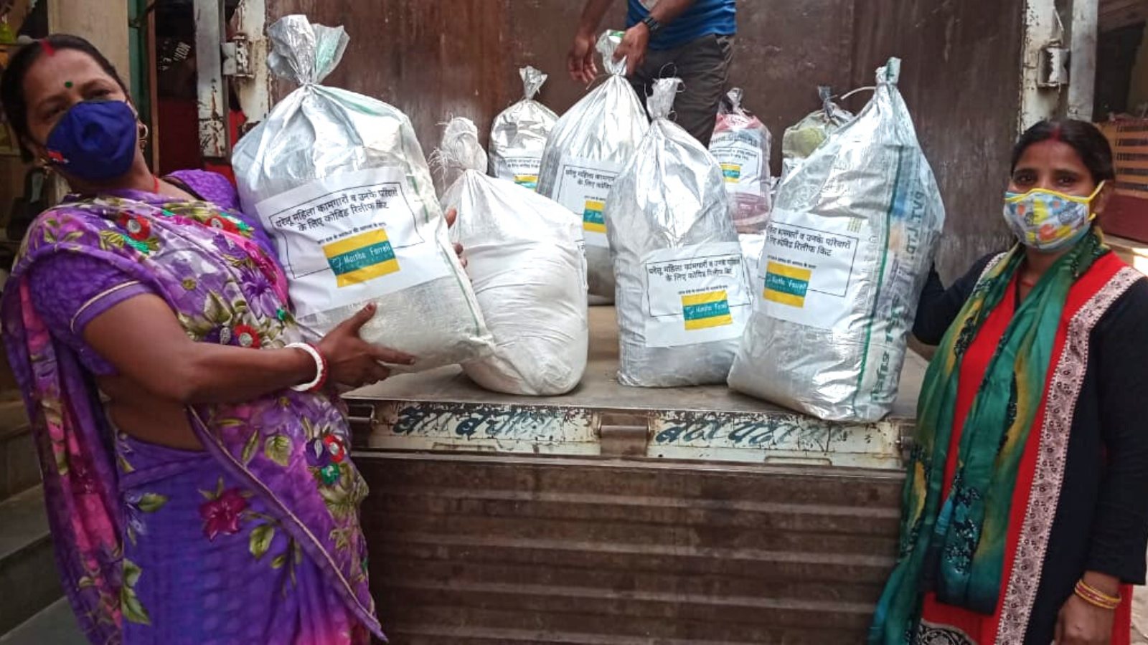
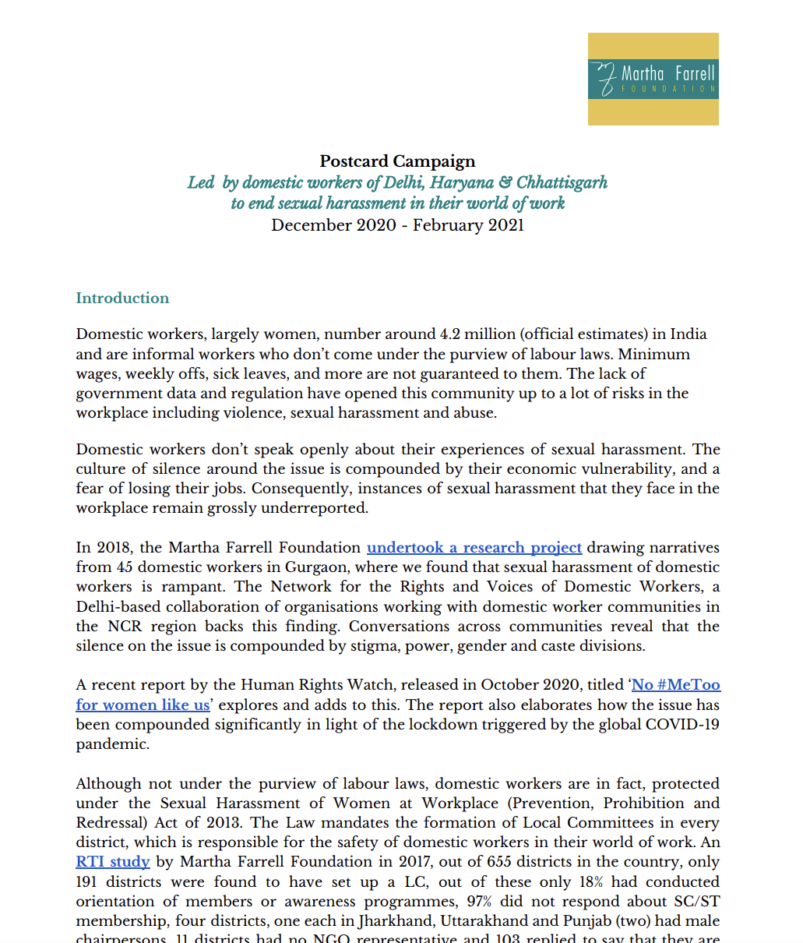
Alternative PR model.. Phase 2:
Joint data-collection
Analysis together, linking micro with macro
DW start to act (collect & distribute relief, connect to health services)
Together publish findings in media
Researchers frame larger study based on this
DWs mobilise campaign to influence policy
Researchers & DW frame research
Read here:

Slide 41
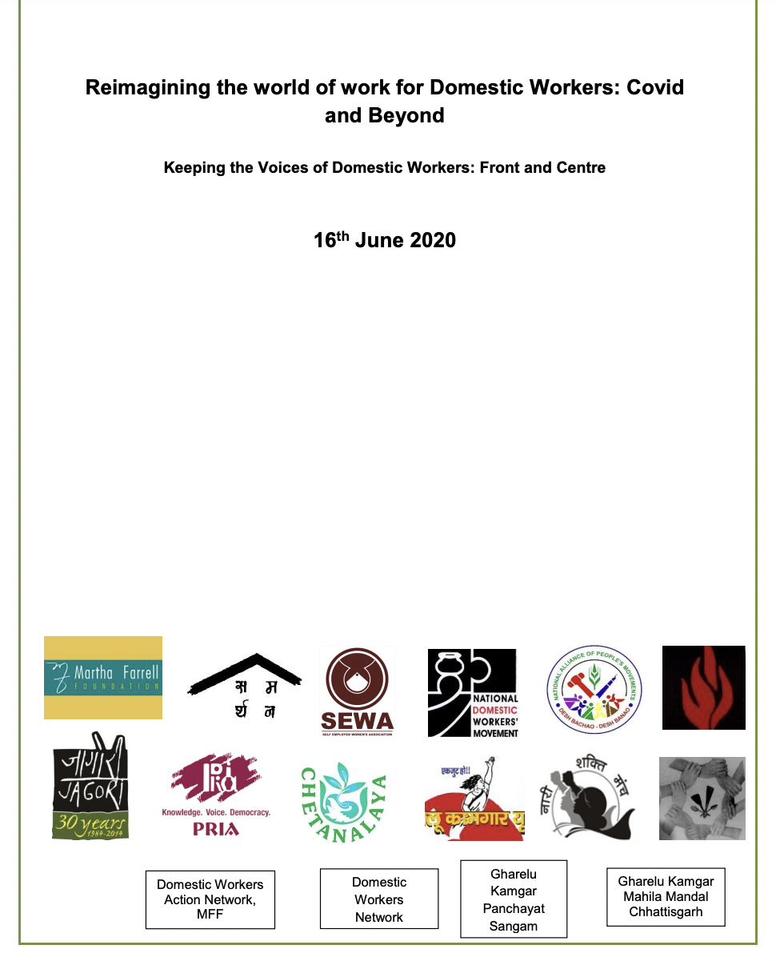
Key Components of PR Model
Build trusting partnerships
Support awareness-raising
Share evidence for policy influencing
Recognise & value experiential knowledge
Jointly frame Research Questions
Involve in data-collection & analysis
Use multiple methods of dissemination of findings
Read here

Slide 42
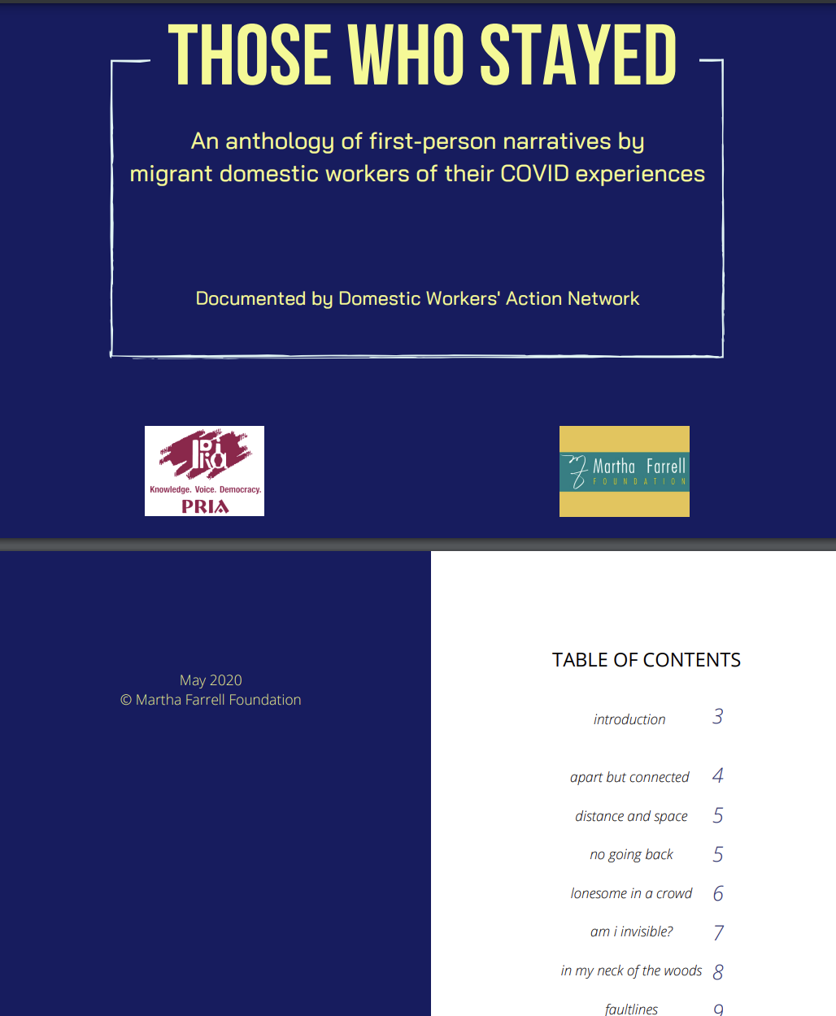
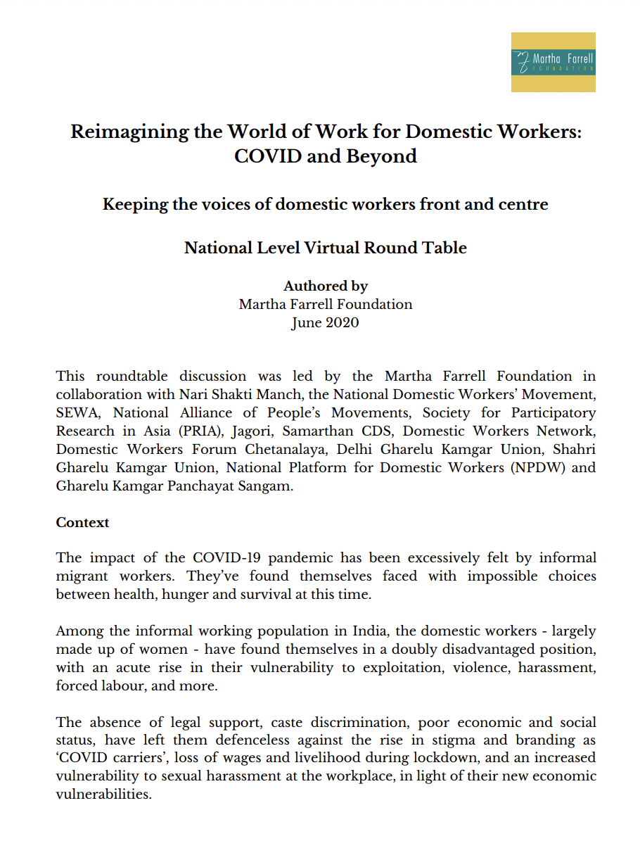
Contact us!
Dr. Rajesh Tandon and Dr. Budd Hall
@RTandon_PRIA @buddhall
@UNESCOchairCBR
@UNESCOChairCBR
Email:
rajesh.tandon@pria.org
bhall@uvic.ca
Websites:
www.pria.org, www.unescochair-cbrsr.org
Read here
Read here
Read here

Slide 43
Impact of Social Sciences, Humanities and Arts
13-15 October, 2021
Geoff Mulgan
Professor of Collective Intelligence, Public Policy
and Social Innovation at University College London, UK
#SSHA21

Slide 44
Professor
Sir Geoff Mulgan, UCL

Slide 45
How to better align science with social priorities How to mobilise knowledge to support decisions How to reorient social science to designs for the future

Slide 46
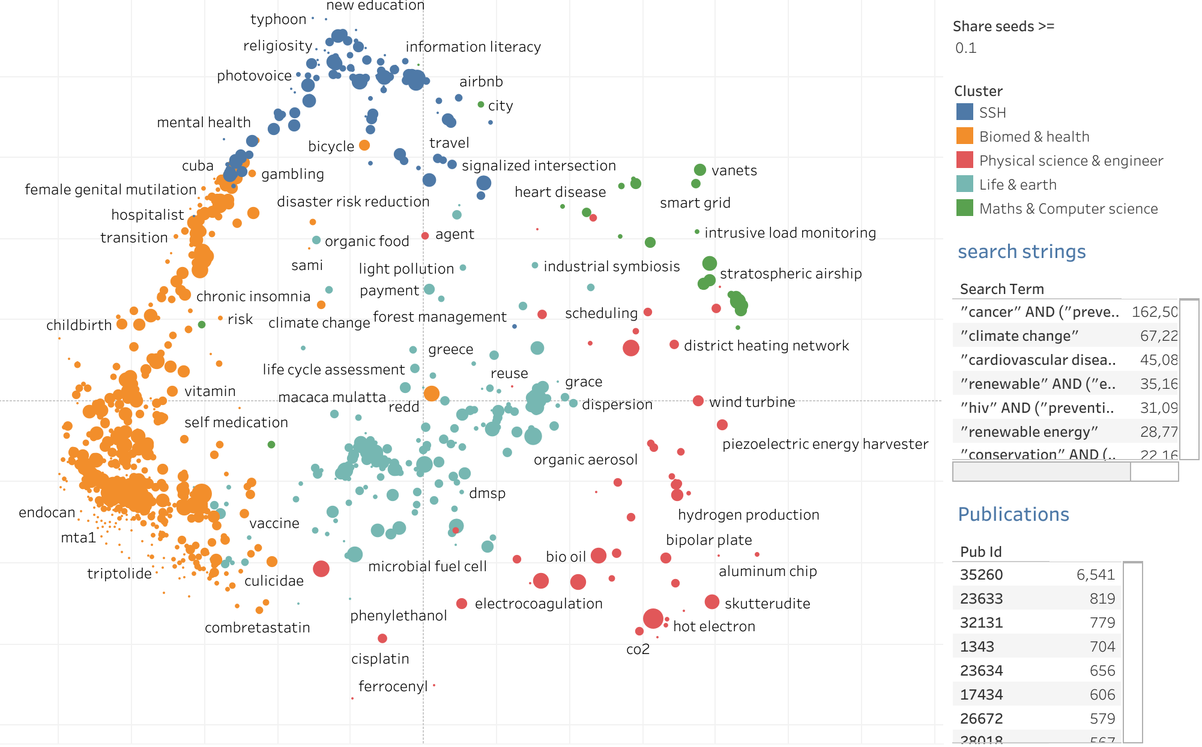

Slide 47
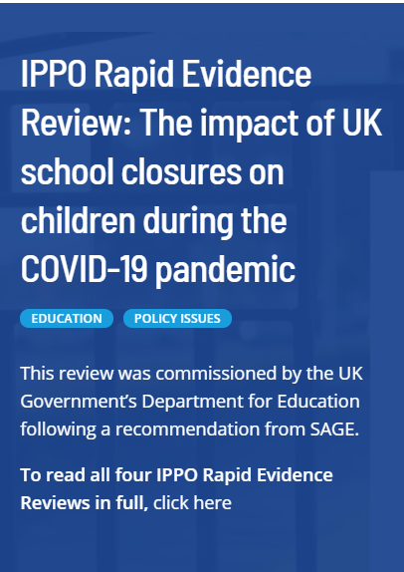
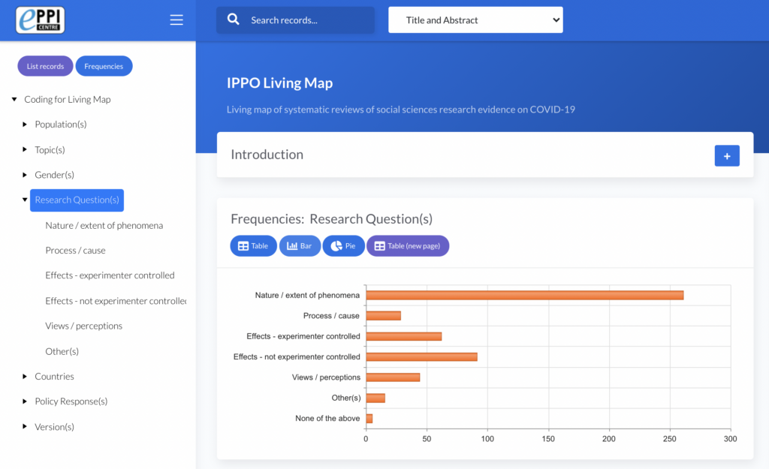
​The International Public Policy Observatory helps governments to: ​
make better short- and longer-term policy decisions throughout the different stages of the COVID-19 crisis and recovery, drawing on global evidence and experience
focused on the social impacts of COVID-19, including: mental health; education; housing; care; Black, Asian & Minority Ethnic Communities; Vulnerable Communities; online Life.

Slide 48
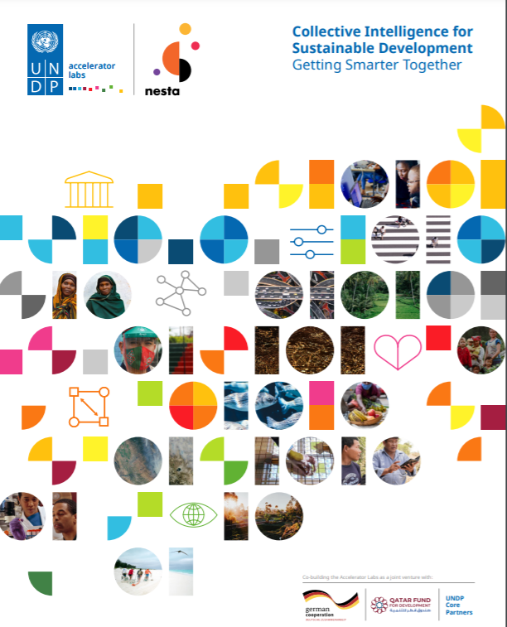
More systematic mobilization of intelligence of all kinds – data, evidence, citizen insight – with collective intelligence as the core of good government

Slide 49
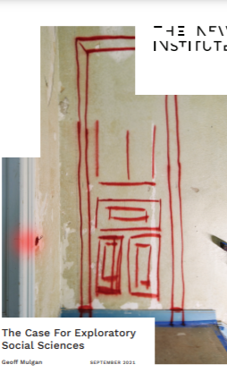
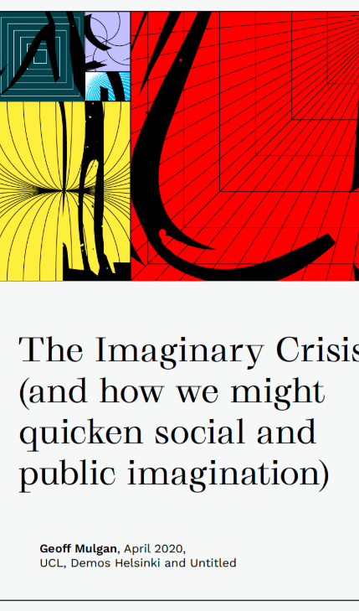

Slide 50
Better align science with social priorities – using data and new governance arrangements Mobilise knowledge to support decisions – moving to more demand-led models Grow exploratory social science teams and methods Fuel imagination!

Slide 51
Impact of Social Sciences, Humanities and Arts
13-15 October, 2021
Thank you!
#SSHA21

